Slide 1
Software Engineering – Structured Analysis & ERD
By
Dr. Junaid Akram
Assistant Professor, Department Of Computer Science Comsats (Lahore)

Slide 2
What is Structured Analysis?
Structured Analysis is a development method that allows the analyst to understand the system and its activities in a logical way.
It is a systematic approach, which uses graphical tools that:
Analyze and refine the requirements of an existing system
Develop a new system specification which can be easily understandable by user.
To establish a basis for creation of a software design.

Slide 3
What is Structured Analysis? (contd.)
It has following attributes:
It is graphic which specifies the presentation of application.
It divides the processes so that it gives a clear picture of system flow.
It is logical rather than physical i.e., the elements of system do not depend on vendor or hardware.
It is an approach that works from high-level overviews to lower-level details.

Slide 4
Structure of the Analysis Model
Process Specification
Data Object Description
Entity –Relationship Diagram
(ERD)
Data – Flow Diagram
(DFD)
Data
Dictionary
State – Transition Diagram
(STD)
Control Specification

Slide 5
Data Dictionary Contents
Name
the primary name of the data or control item, the data store or an external entity
Alias
other names used for the first entry
Where used/how used
a listing of the processes that use the data or control item and how it is used (e.g., input to the process, output from the process, as a store, as an external entity
Content description
a notation for representing content
Supplementary information
other information about data types, preset values (if known), restrictions or limitations, and so forth

Slide 6
Data Dictionary Example
Name: telephone number
Aliases: none
Where used/ how used: assess against set-up (output)
dial phone (output)
Description:
telephone number = [local number | long distance number]
local number = prefix + access number
long distance number = 1 + area code + local number
area code = [800 | 888 | xyz]
prefix = * a three digit number that never starts with 0 or 1 *
access number = * any four number string *

Slide 7
Structure of the Analysis Model
Process Specification
Data Object Description
Entity –Relationship Diagram
(ERD)
Data – Flow Diagram
(DFD)
Data
Dictionary
State – Transition Diagram
(STD)
Control Specification

Slide 8
Entity Relationship Diagram (ERD)
Is a type of structural diagram for use in database design.
An ERD contains different symbols and connectors that visualize two important information:
The major entities within the system scope,
The inter-relationships among these entities.

Slide 9
(ERD) Contd…
When we talk about “Entities” in ERD, very often we are referring to business objects such as:
People/roles (e.g. Student)
Tangible business objects (e.g. Product)
Intangible business objects (e.g. Log)
When we talk about "Relationship" is about how these entities relate to each other within the system.

Slide 10
Data Objects, Attributes & Relationships
Data object
representation of almost any composite information that must be understood by software
Composite information
number of different properties or attributes
Data object description incorporates the data object and all of its attributes.
Relationships are always defined by the context of the problem being analyzed

Slide 11


Data Objects, Attributes & Relationships (cont.)
Objects: | Attributes | Relationships
 | Name Address Age Driver’s license number
 |  | Owns
 | Make Model ID number Body type Color

Slide 12
(ERD) Contd…
Entities include: Author, Publisher, Customer, Book, and Warehouse
Each entity has its own attributes (i.e. properties) that we want to store about that entity
Each entity must have a primary key, which is a unique attribute to uniquely identify each record in that entity
Relationships may be one-to-one, one-to-many- or many-to-many
Foreign keys are used to connect entities in one-to-many relationships
Many-to-many relationships are logical relations that can be devided into two one-to-many relationships such as (from the example in the next slide):
ShoppingBasket_Book: each book can be in many shopping baskets and each shopping basket can have many books
Warehouse_Book: each warehouse has many books and each book may be contained in many warehouses.

Slide 13
Data Objects
External entity –anything that produces or consumes information
Thing (e.g., car, reports, displays, signals)
Occurrence or events (e.g., telephone call, interrupt, alarm)
Role (e.g., student, manager, engineer, salesperson)
Organizational unit (e.g., Dept. CS, division, team)
Place (e.g., AAST Abu QIR, manufacturing floor)
Structure (e.g., students file, employee record)

Slide 14
Data Objects
Data objects are frequently represented as a table
Naming Attributes
Descriptive Attributes
Referential Attributes
identifier
Make | Model | ID# | Body Type | Color | Owner
Lexus | LS 400 | AB123… | Sedan | White | RSP
V.W. | Beetle | X456… | Sports | Pink | VP
BMW | 750IL | XZ765… | Coupe | Blue | GG
Ford | Taurus | Q12A5… | Sedan | White | MDG
Instance

Slide 15
Attributes
Define properties of a data object
Take on one of three different characteristics
Name an instance of the data object
Describe the instance
Make reference to another instance in another table
One or more attributes must be defined as an identifier which becomes key when we want to find an instance of the data object
The set of attributes is determined through understanding of the problem context

Slide 16
Relationships
Orders
Displays
Stocks
Sells
Returns
Book
Bookstore

Slide 17
Cardinality
One-to-one (1:1)
For example, if each customer in a database is associated with one mailing address.
One-to-many (1:M)
For example, a single customer might place an order for multiple products. The customer is associated with multiple entities, but all those entities have a single connection back to the same customer.
Many-to-many (M:N)
For example, at a company where all call center agents work with multiple customers, each agent is associated with multiple customers, and multiple customers might also be associated with multiple agents.

Slide 18
Modality
1 ( | )
if an occurrence of the relationship is mandatory
0 ( )
if there is no explicit need for the relationship to occur or the relationship is optional

Slide 19
Cardinality and Modality Example
Each faculty member advises many students, each student has only one advisor
Every faculty member may not be an advisor, each student must have an advisor
Cardinality: One
Cardinality: Many
Faculty
Student
Modality: mandatory
Modality: optional

Slide 20
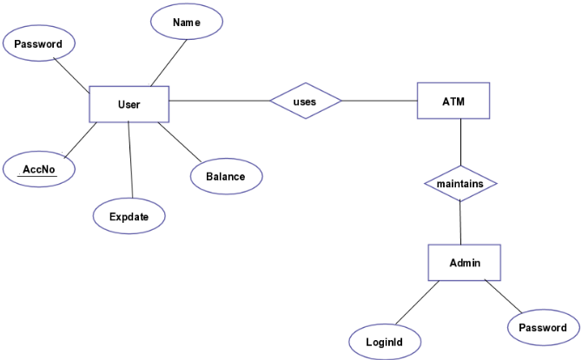
ERD Example 1 (ATM)

Slide 21
ERD Example 2 (Car Manufacturing)
Dealership
licenses
Stocks
Manufacturer
Car
build
Contracts
Shipper
Transports

Slide 22
ERD Example 2 (cont.)
Dealership
licenses
Stocks
Manufacturer
Car
build
Shipper
Transports
Contracts

Slide 23
ERD Example 3
1 instance of sales rep services 0 to many customers.
1 instance of customers places1 to many orders.
1 instance of an order lists 1 to many products.
1 instance of warehouse stores 0 to many products.

Slide 24
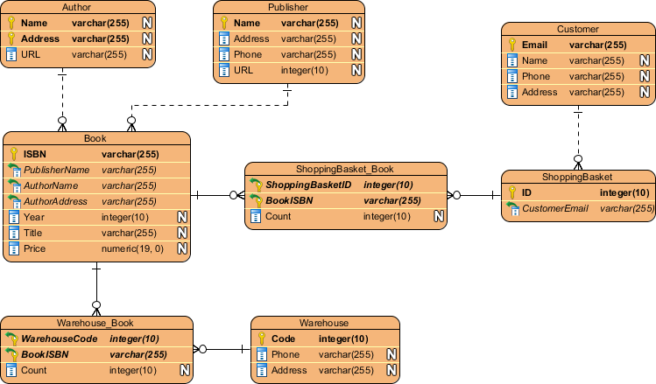
Entity Relationship Diagram Example..
Notes:
A dashed line means that the relationship is strong, whereas a solid line means that the relationship is weak.

Slide 25

Thanks for your attention!
Any Question?

